Slide 1
Mutual fund Prospectus

Slide 2
Let’s Start to pick up funds
1. American Funds
US has around 10000 mutual funds. How to choose those funds suites you most?
https://www.americanfunds.com/default-home.htm
2. Chinese funds
http://fund.csrc.gov.cn/web/fund_type_affiche.fund_affiche
http://finance.sina.com.cn/fund/

Slide 3
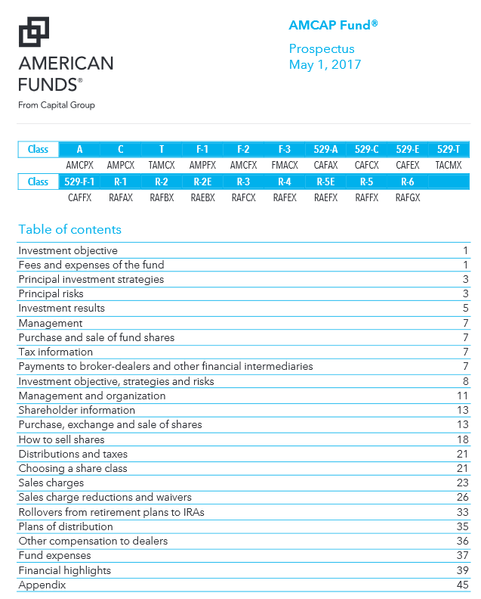
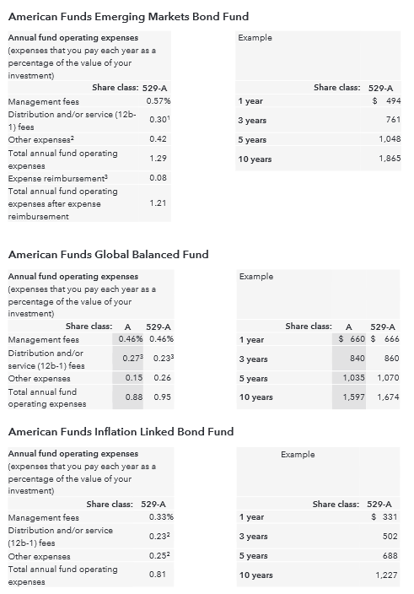

Slide 4
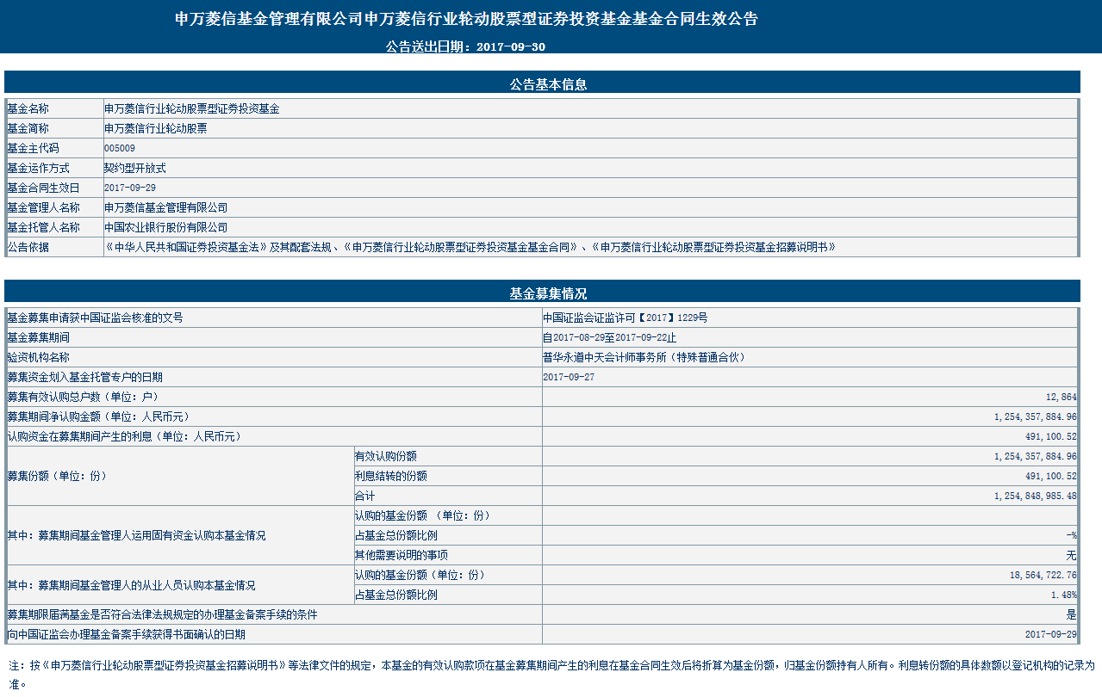

Slide 5
How to Choose Your Own Mutual funds
Different Types of funds has different return & risk characteristics
Even funds within the same typology, they may have different investment strategy, expected return and risk features
Before making investment decision, investor should know
investment objective
risk tolerance
investment time horizon
Fund characteristics

Slide 6
Step 1: Know yourself
Understand your investment objective & risk tolerance
What do you expect from the investment
Eg: breakfast from YUEBAO?
Generate cash flow
Buy a house in 5 years?
Your risk tolerance
The Younger the investor, the better of risk tolerance; aggressive
People in their Middle age, average risk tolerance
Old aged, conservative
Risk tolerance also related to your wealth
Personal Risk Appetite

Slide 7
Step 2: Understand investment Horizon
Long Term: Equity & Bond; Short term: Money market
5 years 7 above: Stock Funds: High volatility, high expected return
3~5 years: Distribution among Equity & Fixed income funds; Balanced funds
3~5 years (conservative): Principle protected funds
Less than 2 years: Fixed income funds
Cash equivalent: Money market funds
Notes:
理清资金的性质很重要，可以长期使用的资金可以投资于股票型基金和混合基金，而短期资金需要流动性，则适合投资债券型和货币型的基金
股票型基金预期收益率较高，但不适合短期投资，其投资期一般应该5年以上。这样既可以抵御一些投资价值短期波动的风险，又可获得长期增值的机会，预期收益率会比较高。这里需要强调的是，我们一定要捺得住长期投资的寂寞，在2006年的牛市行情中，如果自己手中的股票型基金一直持有，那么收益翻番便轻而易举，但很多人选择了提前赎回。因此建议投资者在股票市场上涨趋势明显的情况下，一定要耐心持有手中的优质基金。 保本基金是在一定的投资期内（比如3年或5年），为投资者提供一定本金保障的理财品种，因此也适合长期投资。如果中间赎回的话，不但手续费高，本金也无法得到保障。
投资期限2－5年的中期投资，除了股票类基金这类风险高的基金产品，还要加入一些收益比较稳定的债券型或平衡型基金，以获得比较稳定的现金流。
投资期限在2年以下的短期投资，投资的重点就应该放在债券型基金、货币市场基金这类低风险、收益稳定的基金产品上。货币基金，流动性几乎等同于活期存款，又因其不收取申购、赎回费用，投资者在用款的时候可以随时赎回变现，是短期投资者现金管理的工具。

Slide 8
Step 3: Know Your Investment
What do they do with your money?
What are the investment returns?
What are the risks are you facing?
How do they charge you?
Etc.

Slide 9
Mutual Fund prospectus
A mutual fund prospectus explains how a fund operates, what its performance has been over several years and how much you will pay to purchase and hold your shares.
Federal regulations require each fund to have a prospectus.
To get information about funds:
1) Summary prospectus;
2) Statutory Prospectus;
3) Statement of additional information
Notes:
Mutual funds must provide a copy of the fund prospectus to shareholders after they purchase shares, but investors can � and should � request and read the fund prospectus before making an investment decision. There are two kinds of prospectuses:
the statutory prospectus; and
the Summary Prospectus. The statutory prospectus is the traditional, long-form prospectus with which most mutual fund investors are familiar. The Summary Prospectus, which is used by many funds, is just a few pages long and contains key information about a fund.
Both kinds of prospectuses contain important information, including the fund's investment objectives or goals, its strategies for achieving those goals, the principal risks of investing in the fund, the fund fees and expenses, and its past performance. Investors can find more detailed information in the statutory prospectus, including information relating to the fund investment advisers and portfolio managers and details on how to purchase and redeem shares.
The SEC specifies the kinds of information that must be included in fund prospectuses and requires funds to present key data, such as fees and past performance, in a standard format so that investors can readily compare different funds. Review a fund prospectus carefully and use tools such as a mutual fund cost calculator when analyzing and comparing funds.
1. Part A, the prospectus, which contains information the regulators believe
to be essential to an investor making an informed decision whether to
purchase the fund’s shares;
2. Part B, the statement of additional information (SAI), which contains
information the disclosure of which the SEC has concluded is not
necessary for investor protection, but which some investors may fi nd
useful; and
3. Part C, further information the SEC requires to complete the registration,
but which is not typically distributed to investors.2
In addition, the SEC in recent years has urged companies to prepare
simpler, more understandable disclosure documents, and as part of this effort
allows funds to prepare a profi le, a shortened, simplifi ed version of the
prospectus.

Slide 10
Mutual Fund prospectus - Continued
Securities Act of 1933, Section 10
Information Required in Prospectus
Registration statement
Legal document
Circular
Investor protection
SEC standard formats
1998, SEC reform, “Plain English”
Notes:
The Securities Exchange Act of 1934 requires that any publicly offered security
be described by a prospectus, and that the prospectus be delivered to anyone
considering purchase of the security. The SEC has expanded upon the 1934 Act
requirements to define exactly what goes into an open end fund prospectus, revising
this definition substantially in 1998.
A mutual fund prospectus, also known as the fund’s registration statement, is a legal document required by the Securities and Exchange Commission (SEC), the federal agency in charge of regulating the securities industry. Per SEC guidelines, mutual fund companies are obligated to provide investors with a prospectus before or upon completion of an initial investment in a fund.
The prospectus must disclose a fund’s investment objective and strategies; that is, it must tell investors what types of securities the fund will invest in and how. It also outlines a fund’s expenses, discusses sales charges that may be associated with an investment in the fund and explains investors’ rights to redeem or exchange shares. The prospectus may also provide an illustration of the fund’s historical performance.
The mutual fund prospectus has long held a reputation of being little more than a multi-page footnote — a minefield of legalese. But that changed in 1998 when the SEC mandated that fund companies adopt a “plain English” approach for their prospectuses. The rule requires issuers to write the cover page, summary and risk factors sections of prospectuses in plain English. The SEC also gave specific guidance on how to make the entire prospectus clear, concise and understandable.
证券时报记者杨波
12月，美国证监会一致通过了基金将采取新招募说明书规定的决议。据悉，这一规定将在2009年2月28号生效，基金公司有十个月的适应期，到2010年1月1日开始，所有公司必须使用简易的招募说明书。
据美国普信全球服务公司副总裁林羿介绍，美国基金法规定基金公司必须向基金投资者提供招募说明书，并且要非常详细地介绍有关基金产品各方面的情况，为了减少承担法律责任与风险的可能性，美国基金公司通常把招募说明写得非常详细甚至繁琐，一份招募说明书可能就有7、80页甚至上百页。
林羿告诉记者，为了降低成本，节约资源，多年以来，基金公司与投资者一直在呼吁监管部门采取新的简易招募说明书。美国基金业协会2006年进行过相关调查，发现很多投资者根本没打开看过招募书，全国基金投资者中只有不到40%的基民在买基金前会详细阅读说明书，2/3以上的投资者认为招募说明书内容太过繁杂，既起不到为投资者提供信息的目的，基金公司还得在印刷与邮寄方面承担费用，是一种无益的浪费。
据林羿介绍，美国证监会十年前发布过一项规定，基金公司可以向投资者提供较简单的基金招募说明书，但因为既不允许通过电子邮件、公司网站来提供补充介绍，在简况中也不允许进行索引，所以这项规定没能成功解决这个问题。
在这次公布的新规定中，基金公司只需向投资者提供三到四页的招募说明书，允许基金公司通过索引的方式来满足法律对招募说明书的要求，并且可以通过电子邮件或网页的方式为投资者提供，消息公布后立刻获得了基金业与投资者的热烈反响。按新规定，基金招募说明书包括如下内容：必须要用简易的英文来写，不超过三到四页纸，主要内容为投资目标、投资成本、主要投资策略、风险、投资表现、投资顾问和基金经理的简单介绍、申购赎回相关税收方面的信息、有关中介机构的信息，其它法律规定的更详细的内容，可以通过索引的方式来提供。除非基金投资者有要求，否则可以不必邮寄书面的招募说明书。这被视为美国基金业的重大突破，具有里程式的意义。
林羿表示，这一新规对中国基金业也提供了有益的参考。“我们应该充分考虑基金投资者面临的信息超载的问题，真正为投资者购买基金提供有效且方便使用的信息。”
新浪声明：本版文章内容纯属作者个人观点，仅供投资者参考，并不构成投资建议。投资者据此操作，风险自担。

Slide 11
Key information in Prospectus
Issue date and Issuer
Investment objectives
Strategies
Risk/Return
Fees and expenses
Past performance (return bar chart)
Managers/advisers/organization
shareholder service: reinvest, redemption
Notes:
1. The front cover page must contain the fund’sname, the prospectus date, and some standard disclaimer language.
http://mutualfunds.about.com/od/mutualfundbasics/a/prospectus.htm
Investment Objectives -- The goal of the fund is defined in the prospectus. Each mutual fund has a different goal. One fund may have a goal of income with preservation of capital while another fund’s goal might be long-term capital appreciation.
Investment Strategy -- The prospectus details the strategy of the mutual fund. Does the fund invest in stocks and/or bonds? The strategy section will describe if the fund is focused on US investments or international investments or a combination of the two, known as global investments.
Shareholder Information -- The prospectus provides information relating to the purchase and redemption of fund shares. Minimum account balances and tax consequences of buying, selling, holding, or exchanging shares of the fund are listed in this section of the prospectus.
Risks -- The prospectus describes the risks associated with investing in the fund. If the fund invest in equities, for example, prospectus will discuss risks of investing in the stock market. The prospectus will also list risks of investing in the particular strategy of the fund. For example, the prospectus for the US large cap fund Vanguard 500 Index reads: “Large-cap stocks tend to go through cycles of doing better -- or worse -- than the stock market in general. These periods have, in the past, lasted for as long as several years.” You should read about, and understand, the risks of the fund prior to investing.
Performance Information -- You will find performance information sliced in many ways in the prospectus. The total return for various time periods since inception including: calendar year returns, trailing period returns (1 year, 3 year and 5 year, for instance), and both before tax and after tax returns. The performance data is based on formulas set forth by the SEC which allows you to compare performance from one fund to the next with confidence that you are comparing apples to apples. There is probably no reason for me to mention that past performance doesn’t guarantee future performance (but we can hardly discuss performance without the caveat).
Fees and Expenses -- The prospectus lists the shareholder fees and the annual operating expenses of the fund. The shareholder fees consist of sales charges and redemption fees. The operating expenses -- also known as the expense ratio -- include management fees and 12b-1 fees. The prospectus also includes a hypothetical investment and the impact these fees and expenses would have on the hypothetical investment over time. The hypothetical example will allow you to compare the costs of investing in one fund covered by the prospectus versus costs of investing in other mutual funds.
Financial Highlights -- The financial highlights section of the prospectus includes audited data that is derived from the fund’s financial statements. The data is listed in a table and includes a reconciliation of the beginning period net asset value and ending period net asset value (for five calendar years). In other words, what was the fund worth at the beginning of the year, how much did it earn, what were the charges, and how much was the fund worth at the end of the year.
Where Can You Find a Prospectus?
While the mutual fund prospectus contains a plethora of information that might seem overwhelming, it includes valuable information. Many of your questions can be answered by simply thumbing through the prospectus prior to investing. You can find the prospectus at the mutual fund company’s website or on the SEC’s EDGAR system.

Slide 12
To Understand Prospectus, you should know:
Mutual fund classes:
Class A, Class B, Class C, Class I , Class R;
Class A: front-end sales charge
Class B: back-end asset-based sales charges
Class C: Lower back load, higher service fee
Class I : for institutional investors
Class R: for pension plan, 401 (k)
A single mutual fund, with one portfolio and one investment adviser, may offer more than one "class" of its shares to investors. Each class represents a similar interest in the mutual fund's portfolio. The principal difference between the classes is that the mutual fund will charge you different fees and expenses depending on the class you choose.
Notes:
Mutual fund classes:
As an investor, you may have read about Class A, Class B, Class C or other classes of mutual fund shares. If you are thinking about choosing one of these classes, it is important for you to understand the differences between them.
Since the 1980s mutual funds have developed different classes of shares to be sold through different sales channels. The different share classes are designated by letter and mutual funds may have A, B, C, F, I, R and possibly other share classes. The class of shares an investor owns is dependent on the channel through which the fund was purchased.
Read more: What Is an R-Class Mutual Fund? | eHow.com http://www.ehow.com/about_6581454_r_class-mutual-fund_.html#ixzz1NKM3oN1E
What Are Mutual Fund Classes?
A single mutual fund, with one portfolio and one investment adviser, may offer more than one "class" of its shares to investors. Each class represents a similar interest in the mutual fund's portfolio. The principal difference between the classes is that the mutual fund will charge you different fees and expenses depending on the class you choose.
You'll find a glossary of terms at the end of this document and links to some of these terms within the document's text .
A 529 Plan is an education savings plan operated by a state or educational institution designed to help families set aside funds for future college costs. It is named after Section 529 of the Internal Revenue Code which created these types of savings plans in 1996.
An annual marketing or distribution fee on a mutual fund. The 12b-1 fee is considered an operational expense and, as such, is included in a fund's expense ratio. It is generally between 0.25-1% (the maximum allowed) of a fund's net assets. The fee gets its name from a section in the Investment Company Act of 1940.

Slide 13
Fees/Ratios
Expense – load, no-load, 12b -1 fees
Expense Ratio
A measure of the fund's total annual expenses expressed as a percentage of the fund's net assets.
Turnover Ratio
The percentage of a mutual fund or other investment vehicle's holdings that have been "turned over" or replaced with other holdings in a given year. The type of mutual fund, its investment objective and/or the portfolio manager's investing style will play an important role in determining its turnover ratio.
Notes:
Expense ratio:
A measure of the fund's total annual expenses expressed as a percentage of the fund's net assets. For example, an expense ratio of 1 percent represents an annual charge to the fund's assets—including your proportional interest in those assets—of 1 percent every year.

Slide 14
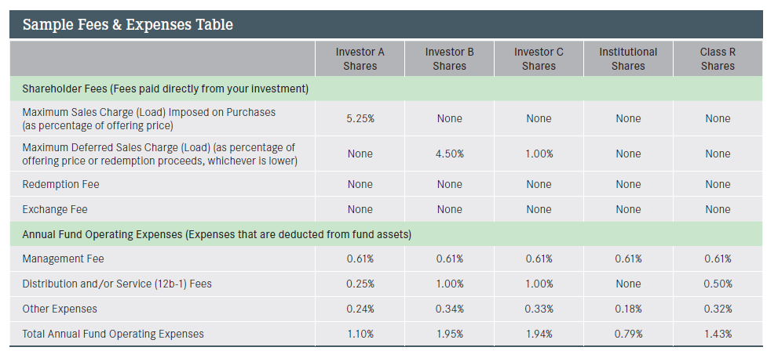
Fee & Expense Table
Notes:
Fee chart: let you compare costs among different funds
payable over 1 year 3 years 5 years 10 years
Class A units $ 11.79 37.16 65.13 148.26
Class I units $ 0.10 0.32 0.57 1.29 by
showing you the costs associated with investing a hypothetical $1,000 over a 1-, 3-, 5-, and 10-year period with 5% return

Slide 15
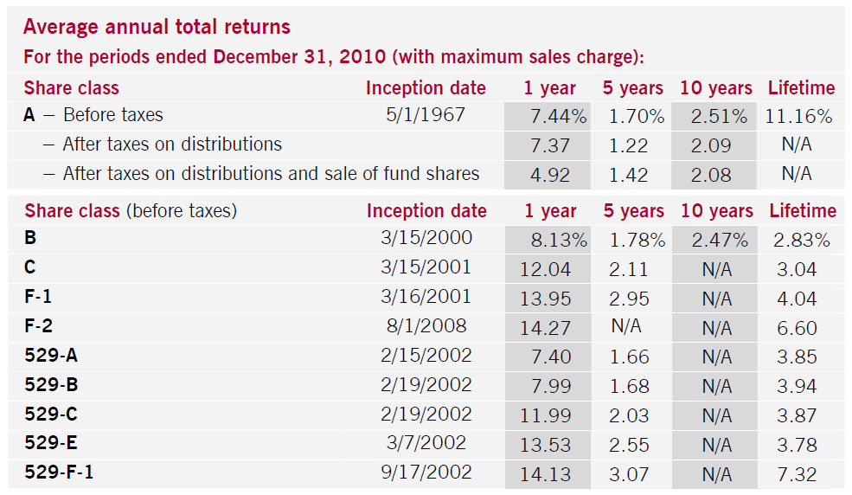
Return

Slide 16
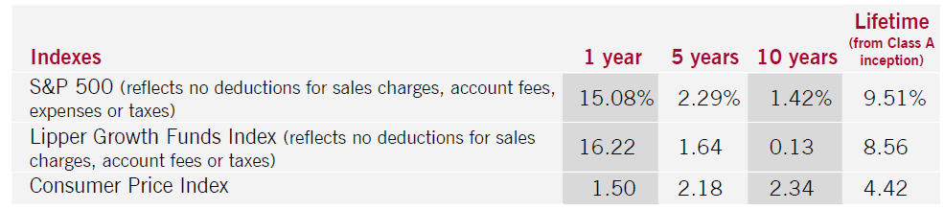
Benchmark index return

Slide 17
Financial Highlights
This section, which generally appears towards the back of the prospectus, contains audited data concerning the fund's financial performance for each of the past 5 years.
Here you'll find net asset values (for both the beginning and end of each period),
total returns, and various ratios, including the ratio of expenses to average net assets, the ratio of net income to average net assets, and the portfolio turnover rate.

Slide 18
模拟prospectus
Name: Scotia Money Market Fund
Fund type: Canadian money market fund
Date established: August 30, 1990
Type of securities: Class A and Class I units of a mutual fund trust
Eligible for registered plans? Yes
Portfolio advisor: Scotia Cassels Investment Counsel Limited

Slide 19
模拟prospectus
What does the fund invest in?
Investment objectives
to provide income and liquidity, while maintaining a high level of safety. It invests primarily in high quality, short-term fixed income securities issued by Canadian federal, provincial and municipal governments, Canadian chartered banks and trust companies, and corporations.

Slide 20
模拟prospectus
Investment strategies
The fund generally invests in securities with a maturity of up to one year. The portfolio advisor uses interest rate, yield curve and credit analysis to select individual investments and to manage the fund’s average term to maturity. The fund aims to maintain a constant unit value of $10.00 by crediting income and capital gains daily and distributing them monthly. The fund may participate in repurchase, reverse repurchase and securities lending transactions to achieve the fund’s overall investment objectives and to enhance the fund’s returns.

Slide 21
模拟prospectus
What are the risks of investing in the fund?
The main risks of investing in this fund are interest rate risk and credit risk.
The fund may have these additional risks: derivative risk; class risk; repurchase and reverse repurchase transaction risk; underlying fund risk; securities lending risk; significant unitholder risk.
Who should invest in this fund?
This fund may be suitable for you if you want interest income and liquidity with a high level of safety or you’re investing for the short term or you’re looking for low risk and safety of principal.

Slide 22
模拟prospectus
Distribution policy
The fund distributes any income by the last business day of each month. It distributes any capital gains by the last business day of each calendar year. Until a cash distribution option is available, distributions on units held in Scotia registered plans are always reinvested in additional units of the fund. Distributions on units held in other registered plans and non-registered
accounts are reinvested in additional units of the fund, unless you tell us in writing that you want to receive cash distributions by cheque or by deposit to your bank account.

Slide 23
Financial Statement basis

Slide 24
Financial Statement
A financial statement that summarizes a company's assets, liabilities and shareholders' equity at a specific point in time. These three balance sheet segments give investors an idea as to what the company owns and owes, as well as the amount invested by the shareholders. The balance sheet must follow the following formula: Assets = Liabilities + Shareholders' Equity
Three sheet: Balance sheet; Income statement; Cash flow Statement

Slide 25
Balance Sheet
It's called a balance sheet because the two sides balance out. This makes sense: a company has to pay for all the things it has (assets) by either borrowing money (liabilities) or getting it from shareholders (shareholders' equity). The balance sheet is one of the most important pieces of financial information issued by a company. It is a snapshot of what a company owns and owes at that point in time. The income statement, on the other hand, shows how much revenue and profit a company has generated over a certain period. Neither statement is better than the other - rather, the financial statements are built to be used together to present a complete picture of a company's finances.

Slide 26
Cash Flow Statement
One of the quarterly financial reports any publicly traded company is required to disclose to the SEC and the public. The document provides aggregate data regarding all cash inflows a company receives from both its ongoing operations and external investment sources, as well as all cash outflows that pay for business activities and investments during a given quarter

Slide 27
Income Statement
financial report summarizing revenues and expenses and showing the net profit or loss in a specified accounting period. It’s the financial performance due to operations as well as other activities rendering gains or losses of a business entity. Also known as the "profit and loss statement" or "statement of revenue and expense".
It displays how well the company can assure success for both itself and its shareholders through the earnings from operations.

Slide 28
Others
Earnings
The net income of a company during a specific period. Net income generally refers to after-tax income.
Earnings are perhaps the single most studied number in a company's financial statements. They show a company's profitability.
Retained Earnings
The percentage of net earnings not paid out as dividends, but retained by the company to be reinvested in its core business or to pay debt. It is recorded under shareholders' equity on the balance sheet. Calculated by adding net income to (or subtracting any net losses from) beginning retained earnings and subtracting any dividends paid to shareholders:

Slide 29
Others
Return on Investment(ROI)
A performance measure used to evaluate the efficiency of an investment or to compare the efficiency of a number of different investments. To calculate ROI, the benefit (return) of an investment is divided by the cost of the investment; the result is expressed as a percentage or a ratio.

Slide 30
Others
Price/Earning (P/E) Ratio
A valuation ratio of a company's current share price compared to its per-share earnings. For example, if a company is currently trading at $43 a share and earnings over the last 12 months were $1.95 per share, the P/E ratio for the stock would be 22.05 ($43/$1.95).

Slide 31
MF Financial Statement sample
http://fund.csrc.gov.cn/web/html_view.instance?instanceid=ff8080812e83b6c0012eecb0bb312f6c#tabItem6_balanceSheet

Slide 32
Weekly Quiz
1. What are the advantages of investing in mutual funds?

